Slide 1
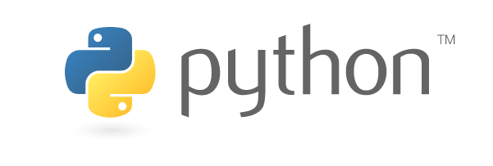
Introduction to Python

Slide 2
Python features – Why Python is GREAT ?!
Interpreted
You need to install Python
Doesn’t need compilation
Multi-platform
Object Oriented
Strongly typed and Dynamically typed
>> a = ‘test’
>> type(a)
Multi purpose (Web, GUI, Scripting, Machine learning)
Fast and flexible (Python Shell)

Slide 3
Python versions
2 main versions Python 2 and Python 3
Most used and recommended version is 2.7
Spark 1.3.1 works with Python 2.6 or higher (but not Python 3)
Anaconda is a Python distribution that contains everything you need (packages)!
Timeline
1994 – Python 1.0
2000 – Python 2.0
2008 – Python 3.0
Adoption to 3.0 takes time
No backward compatibility
print “blabla” 2.x
print(“blabla”) 3.x
The tool called ‘2to3’ can convert most of the project from 2 to 3.
Notes:
Python 3 is supported in Spark 1.5
Here we will use Python 2.7

Slide 4
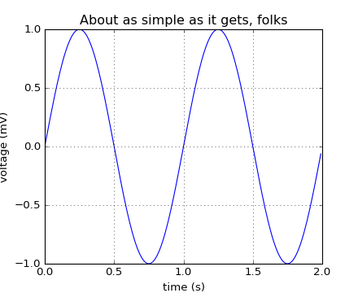
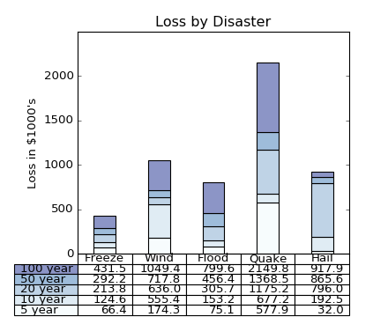
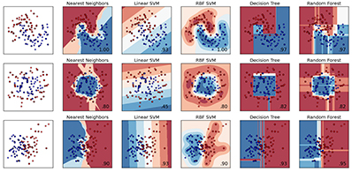
Python packages
A lot of packages !
They are listed in PyPI - the Python Package Index https://pypi.python.org/pypi
Behind a proxy you can use Bandersnatch for mirroring
Famous one:
Numpy: maths, matrices. It has some C dependencies and it is required by PySpark
Matplotlib: graphs, charts, plots
Panda: data structures and data analysis
IPython Notebook (Jupyter): enhanced Interactive Console
SciPy: an ecosystem of all the packages above
scikit-learn: machine learning, data mining/analysis
Very easy to install with pip install <package name>
Anaconda is a Python distribution that contains all of them!
Notes:
Sci(ence) kit learn

Slide 5
Python syntax
Content of test.py
#!/usr/bin/env python
print "Hello World!"
<- This line define for Linux system how execute test.py
$ chmod +x test.py
$ ./test.py
Hello World!
But you can also simply execute with:
$ python test.py
And you can just run Python shell:
$ python
Python 2.6.6 (r266:84292, May 22 2015, 08:34:51)
[GCC 4.4.7 20120313 (Red Hat 4.4.7-15)] on linux2
Type "help", "copyright", "credits" or "license" for more information.
>>>

Slide 6
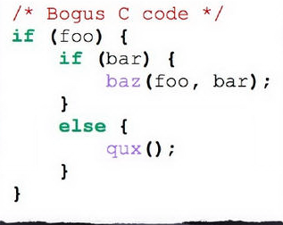
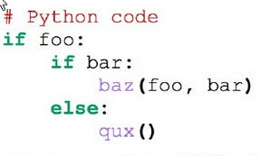
Python syntax – If – Indentation
#!/usr/bin/env python
bl = True
if bl:
print "hey!"
else:
print "nop"
Forget all you know about { } here it is only the indentation that count.
Non-valid indentation will not execute!
Notes:
In C you have the curly bracket and the indentation

Slide 7
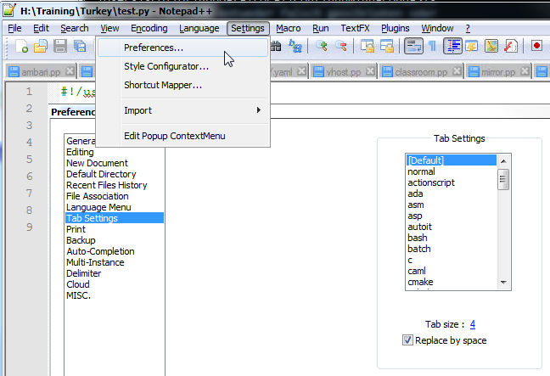
Python syntax – Indentation – Set up your editor!
“Use 4 spaces per indentation level.“
Official Style Guide for Python Code https://www.python.org/dev/peps/pep-0008/#tabs-or-spaces
NEVER mix indentation style, like using Tabs and spaces in the same file

Slide 8
Python syntax - Comment
#!/usr/bin/env python
# One line comment
"""
Several lines block
comment
"""

Slide 9
Python syntax – Types – numbers & lists
# Integers Numbers
year = 2010
year = int("2010")
# Floating Point Numbers
pi = 3.14159265
pi = float("3.14159265")
# Fixed Point Numbers
from decimal import Decimal
price = Decimal("0.02")
optional_data = None
#Lists can be heterogeneous
favotires = []
# Appending with an element
favotires.append(42)
# Extending with another list
favotires.extend([42, "Python", True])
numbers = [1, 2, 3, 4, 5]
len(numbers) # 5
numbers[0] # 1
numbers[1:3] # [2, 3]
numbers[2:] # [3, 4, 5]

Slide 10
Python syntax – Types – Dictionary
Hashmap
person = {}
person['name'] = 'Novewll Strite'
person['favorites'] = [42, 'food']
person['gender'] = 'male‘
print person
{'gender': 'male', 'name': 'Novewll Strite', 'favorites': [42, 'food']}
person.keys()
person.values()
person.items()

Slide 11
Python syntax – Loops
fruits = ['Apple', 'Orange']
for fruit in fruits:
print fruit
#Be careful you cannot modify fruit in the loop.
for x in range(10):
print x
# Not very often used, but equivalent:
x = 0
while x < 10:
print x
x += 1 # There is no x++ operator

Slide 12
Python syntax – Functions
def my_function(param1, param2 = ‘default'):
print "Hey " + param1 + " -> " + param2
my_function('test') # Hey test -> default

Slide 13
Python syntax – Class
class User(object): # Declaration
is_staff = False
def __init__(self, name='Anonymous'):
self.name = name
def is_authorized(self): # Notice that a method contains always “self” as a 1st argument
return self.is_staff # Accessing attributes and methods required “self.”
anonymous = User() # Instantiation
print anonymous.name # Anonymous
print anonymous.is_authorized() # False

Slide 14
Python Exercises
1. Create 2 classes:
Animal
Cat that inherits from Animal
2. List
3. Dictionary

